Slide 1
Week Two– Class One

Slide 2
Constructor
A constructor is a member function of a class which initializes objects of a class.
It has the same name of the class.
It must be a public member.
No Return Values.
Default constructors are called when constructors are not defined for the classes.

Slide 3

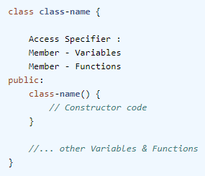
Constructor cont'd
If we do not specify a constructor, C++ compiler generates a default constructor for us (expects no parameters and has an empty body).
For example, in below class Car, constructor name will also be Car().

Slide 4
Advantages
The main purpose of the class constructor in C++ programming is to construct an object of the class. In other word, it is used to initialize all class data members.
For example, in below class, constructor Car () is initializing data members with default values. And, when we create the object of a class, this constructor will always be called.

Slide 5
Example
#include <iostream>
using namespace std;
class Line {
public:
void setLength( double len );
double getLength( );
Line(){
cout<< "Constructor Calling";
} // This is the constructor
private:
double length;
};
void Line::setLength( double len ) {
length = len;
}
double Line::getLength( void ) {
return length;
}
int main() {
Line line;
// set line length
line.setLength(6.0);
cout << "Length of line : " << line.getLength() <<endl;
Line line2;
// set line length
line2.setLength(7.0);
cout << "Length of line : " << line.getLength() <<endl;
return 0;
}

Slide 6
Example 2
#include <iostream>
using namespace std;
class Line {
private:
double length;
public:
Line(){
length=6;
cout<< "Constructor Calling";
} // This is the constructor
double getLength(){
return length;
}
};
int main() {
Line line;
cout << "Length of line : " << line.getLength() <<endl;
Line line2;
cout << "Length of line : " << line.getLength() <<endl;
return 0;
}

Slide 7
Excercise
Write a program and input two integers in main and pass them to default constructor of the class. Show the result of the additon of two numbers.

Slide 8
What is “this” keyword?
The current instance of the class is referred to by this keyword in C++ programming hence; this is known as this Pointer in C++.
This pointer holds the address of current object, in simple words you can say that this pointer points to the current object of the class.
Every object in C++ has access to its own address through an important pointer called this pointer. The this pointer is an implicit parameter to all member functions. Therefore, inside a member function, this may be used to refer to the invoking object.

Slide 9
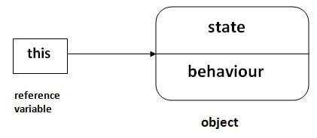
this Pointer
this pointer is a pointer accessible only within the nonstatic member functions of a class,

Slide 10
class ClassName { private: int dataMember; public: method(int a) { // this pointer stores the address of object obj and access dataMember this->dataMember = a; ... .. ... } } int main() { ClassName obj; obj.method(5); ... .. ... }
In C++, this pointer is used to represent the address of an object inside a member function.
For example, consider an object obj calling one of its member function say method() as obj.method(). Then, this pointer will hold the address of object obj inside the member function method().
The this pointer acts as an implicit argument to all the member functions.

Slide 11
USE?
When local variable’s name is same as member’s name
To return reference to the calling object

Slide 12
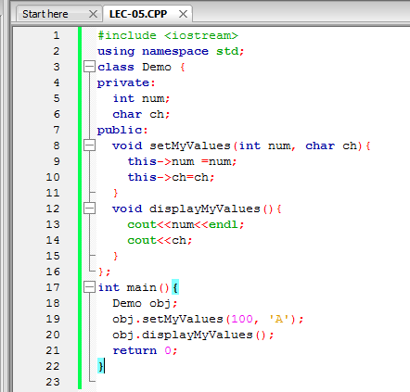
1) When local variable’s name is same as member’s name
you can see that we have two data members num and ch. In member function setMyValues().
we have two local variables having same name as data members' name.
In such case if you want to assign the local variable value to the data members then you won’t be able to do until unless you use this pointer,
because the compiler won’t know that you are referring to object’s data members unless you use this pointer.

Slide 13
1) When local variable’s name is same as member’s name
class Test{
int x;
public:
Test(int x){
x = x;
}
void display(){
cout<<"x = "<<x;
}
};
int main(){
Test ob1(10);
ob1.display();
return 0;
}
class Test{
int x;
public:
Test(int x){
this->x = x;
}
void display(){
cout<<x;
}
};
int main(){
Test ob1(10);
ob1.display();
return 0;
}
Output
x = 0
Output
x = 10

Slide 14
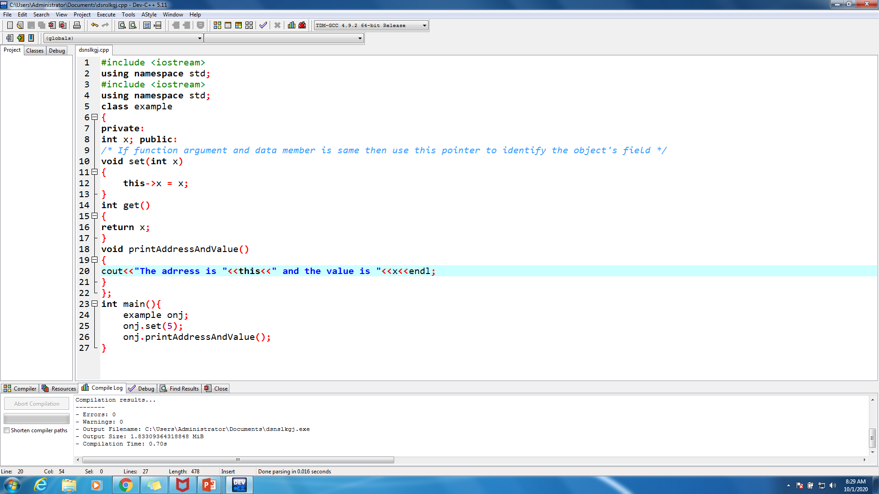
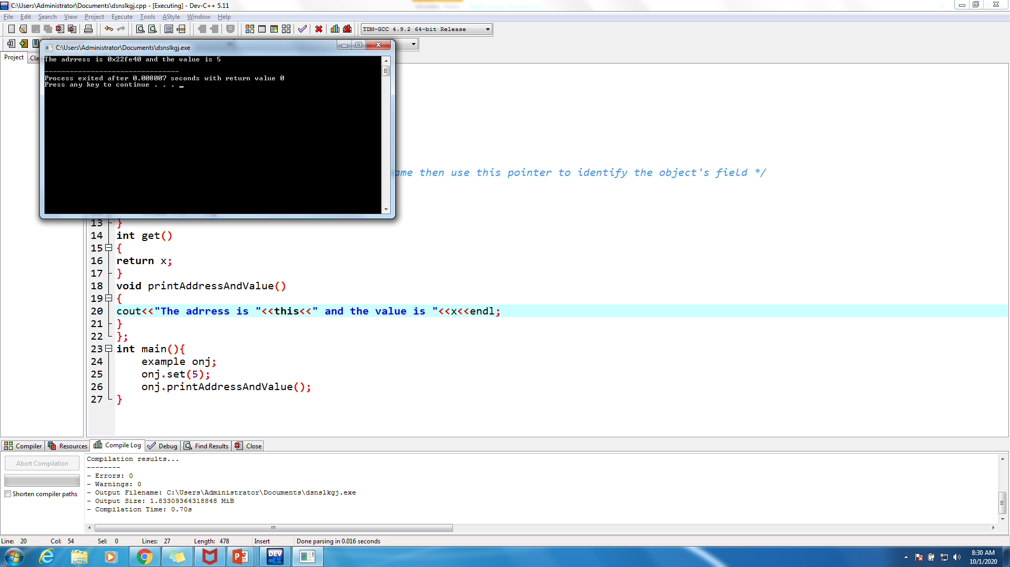
1) When local variable’s name is same as member’s name (cont.)

Slide 15
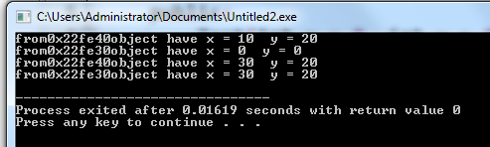
2) To return reference to the calling object
#include <iostream>
using namespace std;
class Test{
int x, y;
public:
Test(int x = 0, int y = 0){
this->x = x;
this->y = y;
}
Test& setX(int a){
x = a;
return *this;
}
Test& setY(int b){
y = b;
return *this;
}
void display(){
cout<<"from"<<this<<"object have x = "<<x<<" y = "<<y<<endl;
}
};
int main(){
Test ob1;
Test ob2;
ob1.setX(10).setY(20);
ob1.display();//10 20 ob2.display(); // 0 0
ob2 = ob1.setX(30);
ob1.display(); //20 30
ob2.display(); //20 30
return 0;
}

Slide 16
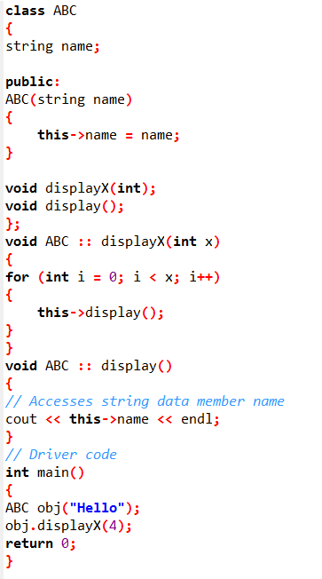
Calling Member Functions Using this Keyword
use this keyword to call member functions associated with the currently executing objects

Slide 17
How Constructors Are Different From A Normal Member Function?
Constructor | Method
Constructor name must be same as class name | functions cannot have same name as class name.
Constructor does not have return type | whereas functions must have.
Constructors are invoked at the time of object creation automatically and cannot be called explicitly | functions are called explicitly using class objects.
Constructors are not inherited by subclasses as they are not members of class | Methods are inherited by subclass to provide the reusability of code.

Slide 18
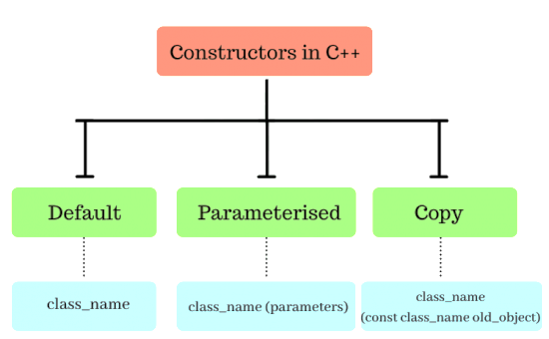
Types of Constructors
Default Constructor: Default constructor is the constructor which doesn’t take any argument. It has no parameters.
Parameterized Constructors: It is possible to pass arguments to constructors. Typically, these arguments help initialize an object when it is created.
Copy Constructor: A copy constructor is a member function which initializes an object using another object of the same class.

Slide 19
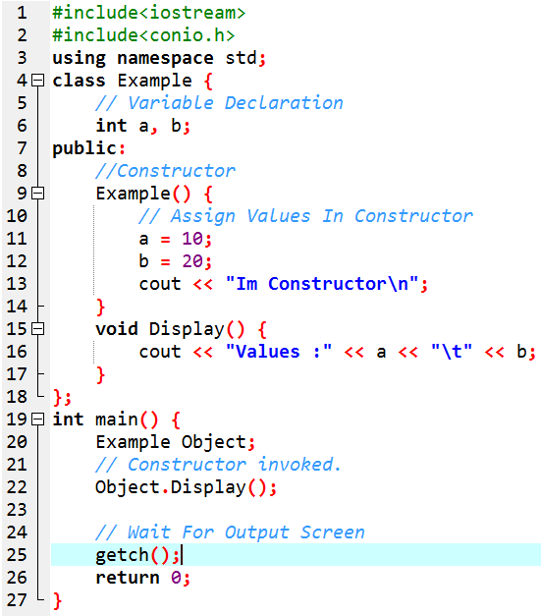
1. Default Constructor
Default constructor is the constructor which doesn’t take any argument. It has no parameters.
In this case, as soon as the object is created the constructor is called which initializes its data members.
A default constructor is so important for initialization of object members, that even if we do not define a constructor explicitly, the compiler will provide a default constructor implicitly.

Slide 20
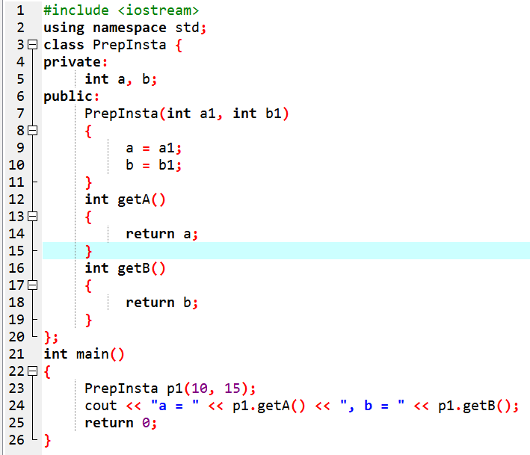
Parameterized Constructors
Arguments can be passed to parameterised constructor.
These arguments help initialize an object when it is created.
To create a parameterized constructor, simply add parameters to it the way you would to any other function.
When you define the constructor’s body, use the parameters to initialize the object.
we can also have more than one constructor in a class and that concept is called constructor overloading.

Slide 21
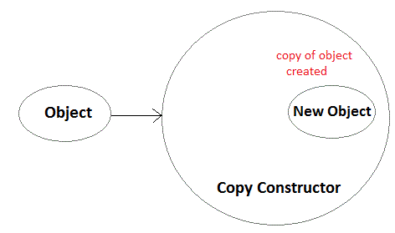
3. Copy Constructor
A copy constructor is a member function which initializes an object using another object of the same class.
A copy constructor has the following general function prototype:
ClassName (const ClassName &old_obj);
The copy constructor in C++ is used to copy data of one object to another.

Slide 22
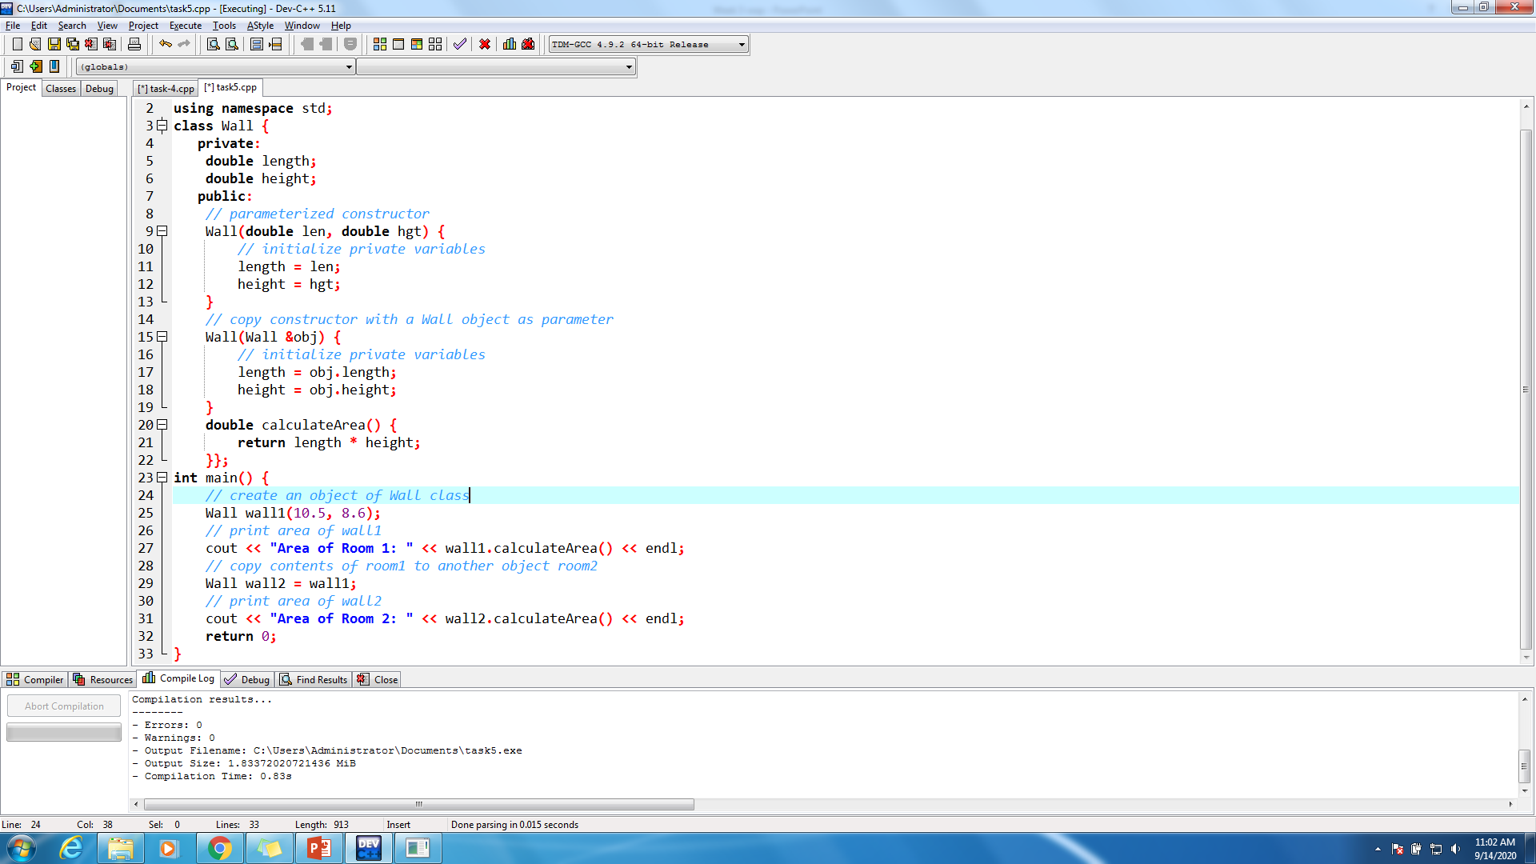
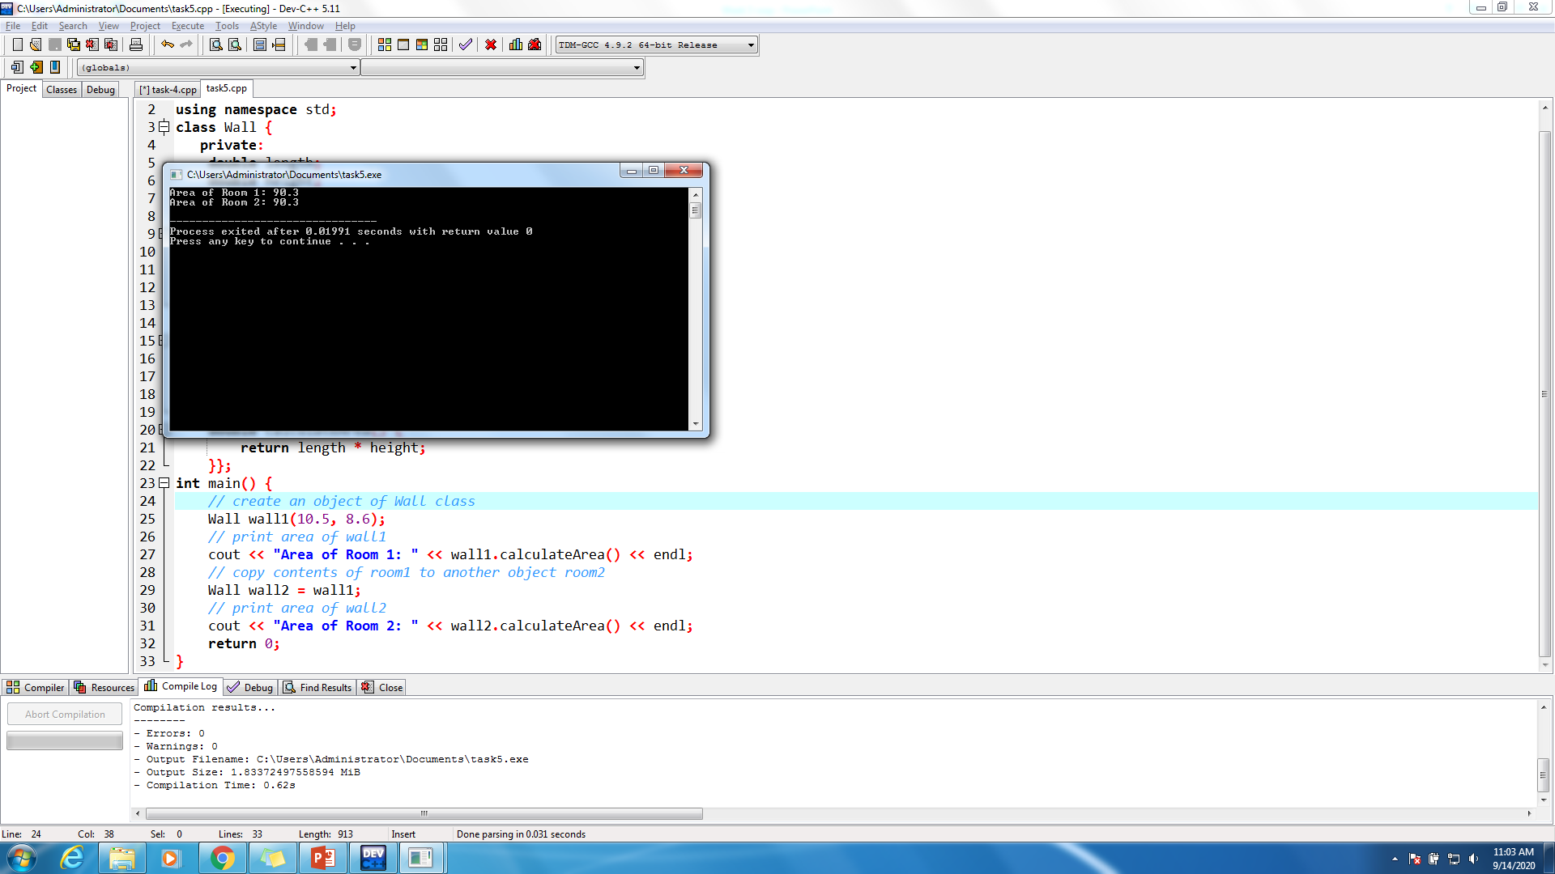
3. Copy Constructor cont’d

Slide 23
Types of Copy Constructors
It is really great way of creating new object initialisations and is still widely used by programmers.
There are two types of copy constructors which are –
Default Copy Constructors (Does Shallow Copying)
User Defined Copy Constructors (Does Deep Copying)

Slide 24
Default &User defined Copy Constructors
Default Copy Constructors –When we don’t define our own version of constructor in that case the compiler creates its own version of copy constructor. The type of copies that are made by default are called shallow copies.
User defined copy constructor – These type of constructors are user enforced and manually created constructors.

Slide 25
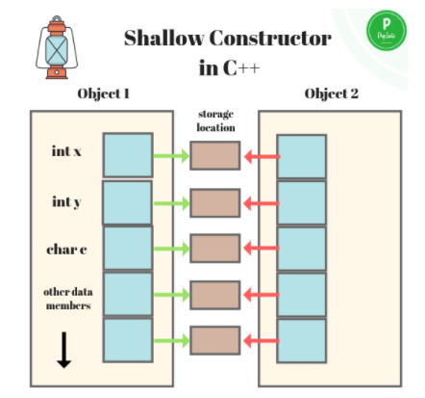
Shallow Copy Constructor
These are in cases when a default copy constructor is created by the compiler itself. In such cases, as explained in the image, there maybe two different objects, once of which is created via default constructor called by compiler.
The objects do not have their individual storage locations, however, are referring to common storage location

Slide 26
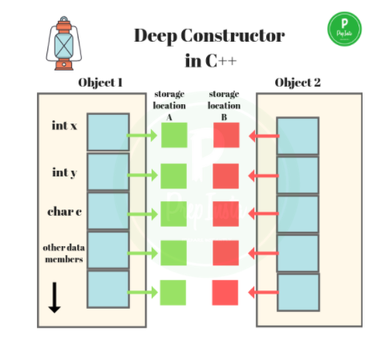
Deep Copy Constructor
At times when there is involvement of pointers and in some cases run time allocation of resources, like file handle, a network connection and others. We may encounter problem with direct assignment operator.

Slide 27
Week-Three Class-III

Slide 28
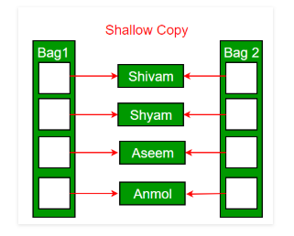
Shallow Copy Vs Deep Copy
Default constructor does only shallow copy.

Slide 29
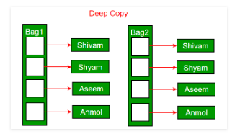
Shallow Copy Vs Deep Copy
Deep copy is possible only with user defined copy constructor. In user defined copy constructor, we make sure that pointers (or references) of copied object point to new memory locations.

Slide 30
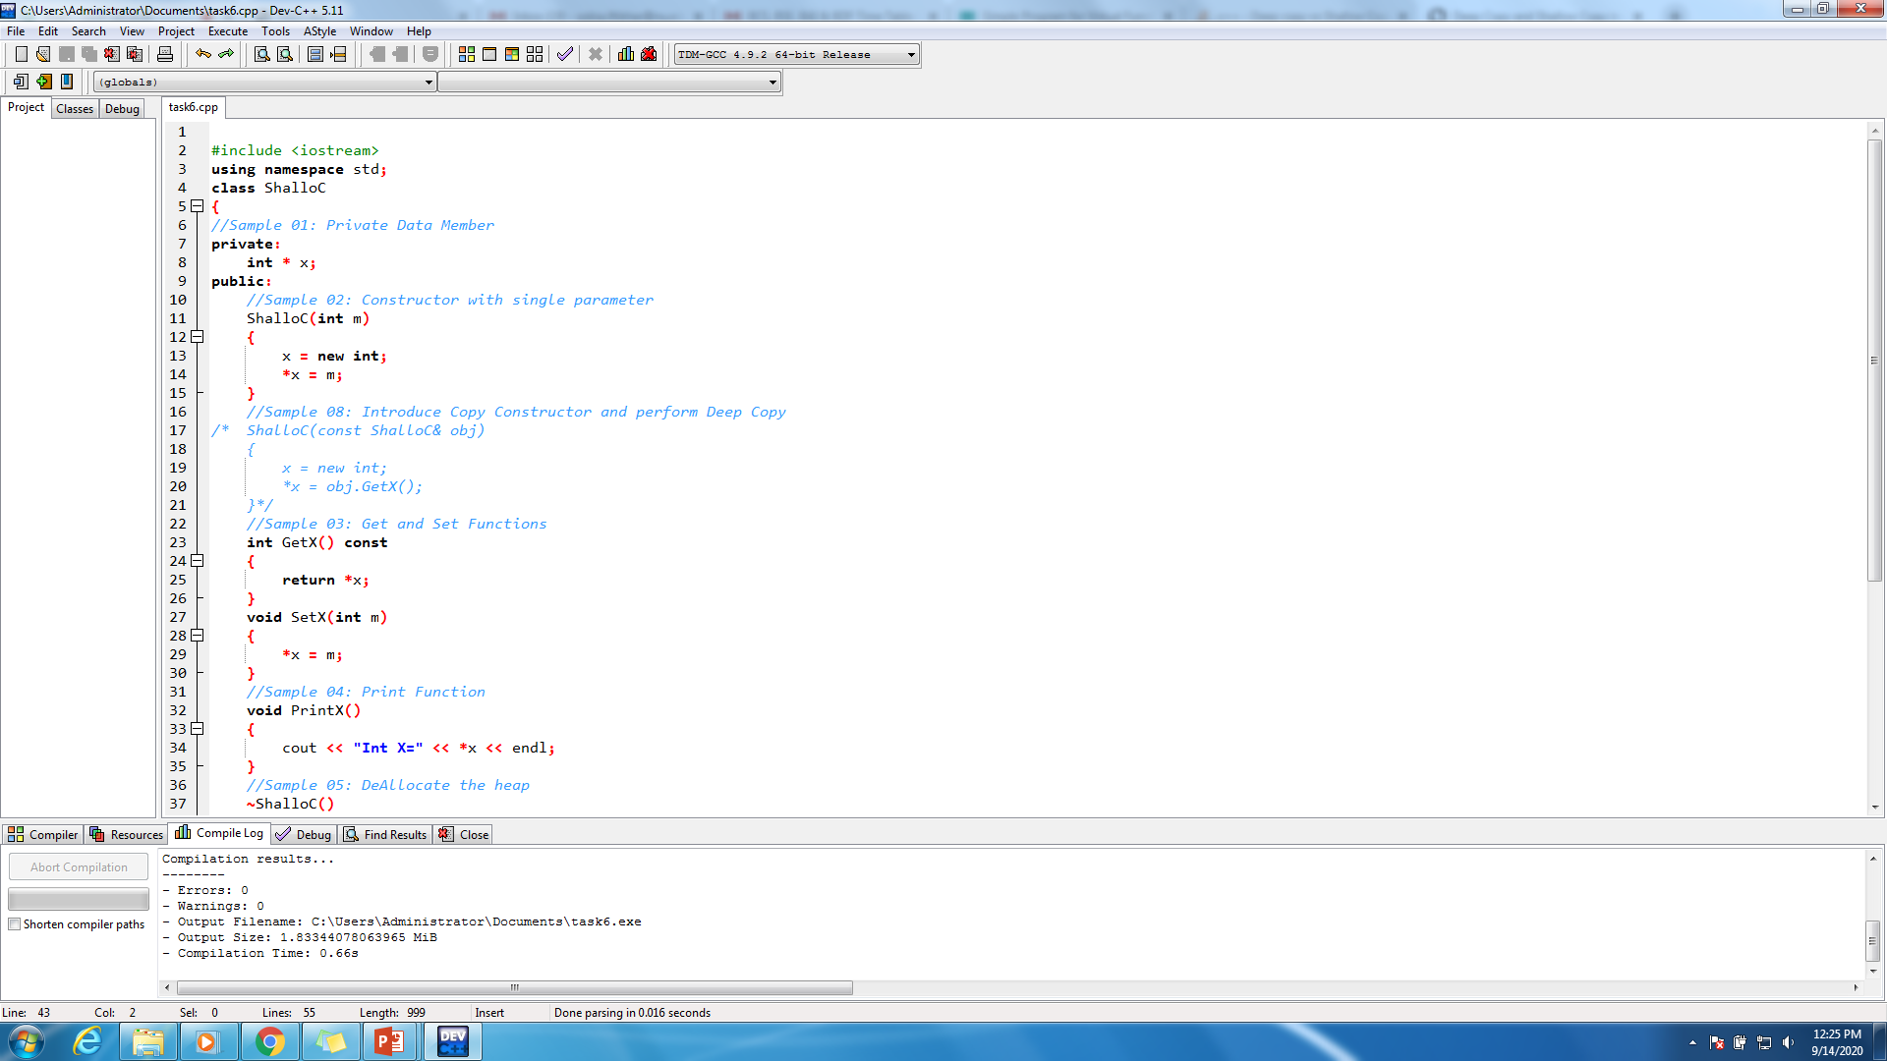
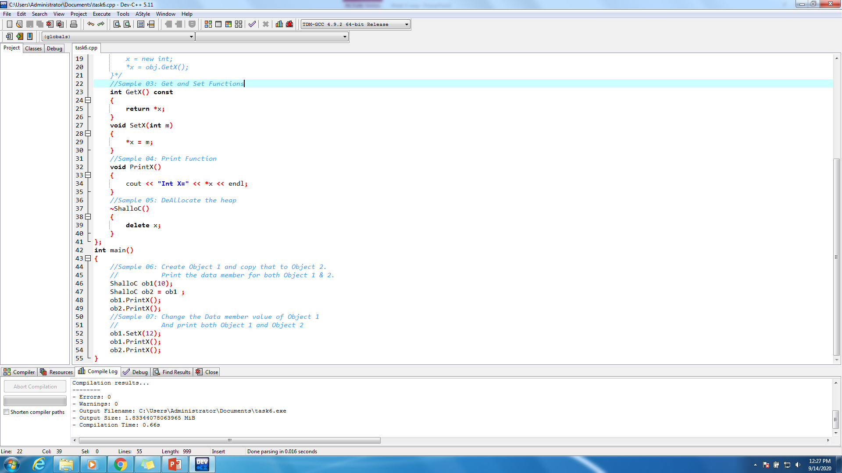

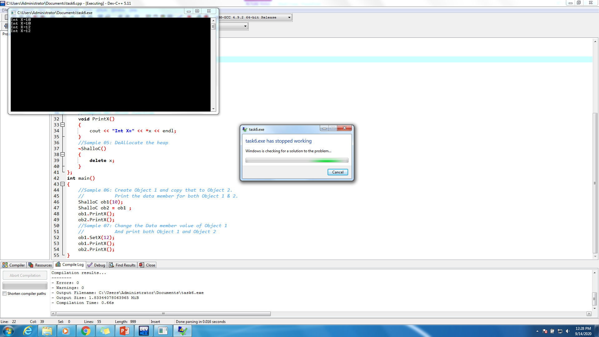
Example-Shallow

Slide 31
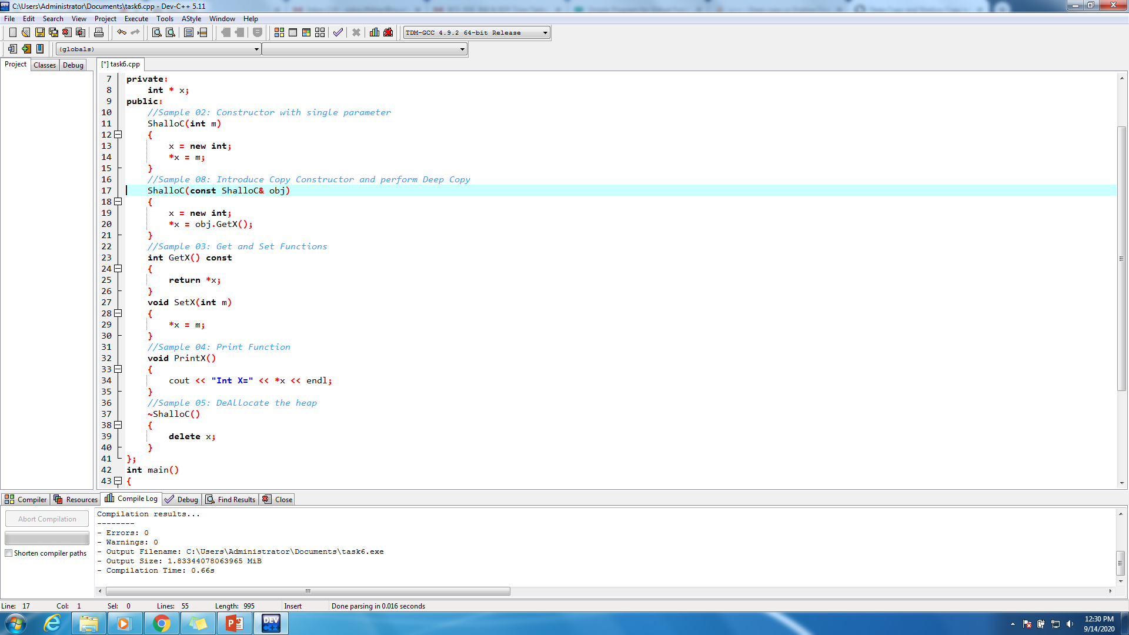
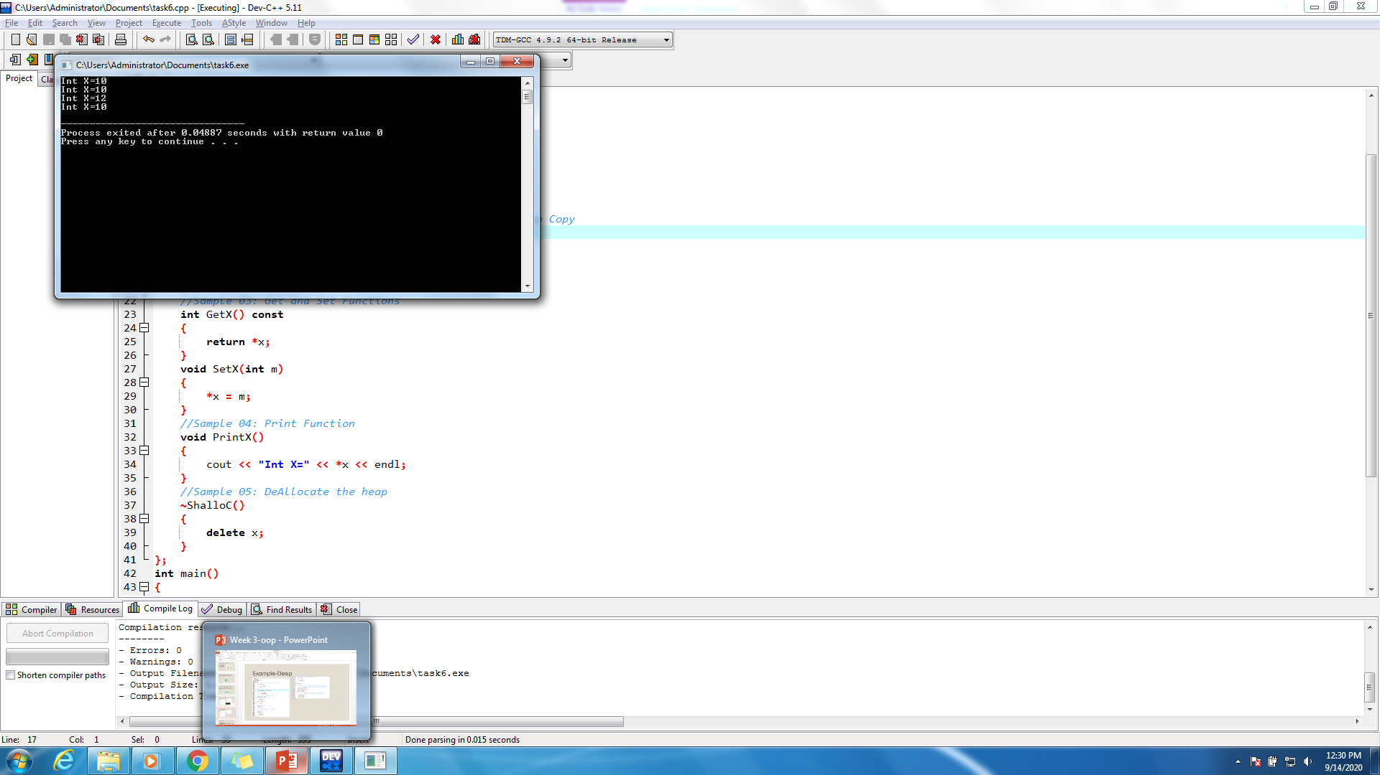
Example-Deep

Slide 32
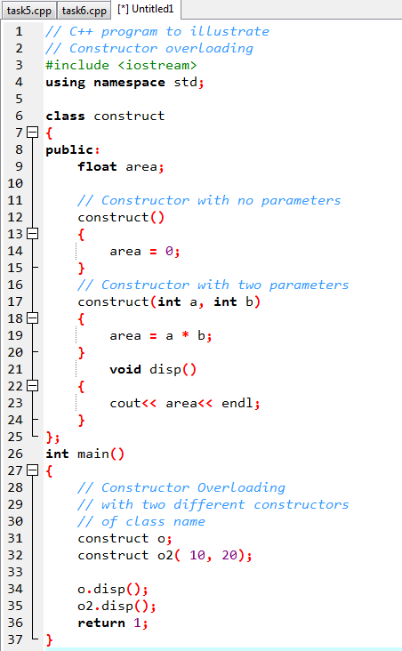
Constructor overloading
Just like other member functions, constructors can also be overloaded. Infact when you have both default and parameterized constructors defined in your class you are having Overloaded Constructors, one with no parameter and other with parameter.
You can have any number of Constructors in a class that differ in parameter list.

Slide 33
Destructors
Destructor is a member function which destructs or deletes an object.
When is destructor called? A destructor function is called automatically when the object goes out of scope: (1) the function ends (2) the program ends (3) a block containing local variables ends (4) a delete operator is called

Slide 34
Order of calling Destructors
class MyClass
{ int objectID; MyClass(int objectID1) { objectID = objectID1; } ~MyClass() { cout << objectID << “ deleted”; }
}

Slide 35
Example
#include <iostream>
using namespace std;
class ABC
{
public:
ABC () //constructor defined
{
cout << "Hey look I am in constructor" << endl;
}
~ABC() //destructor defined
{
cout << "Hey look I am in destructor" << endl;
}
};

Slide 36
Example
int main()
{
ABC cc1; //constructor is called
ABC cc2; //constructor is called
cout << "function main is terminating...." << endl;
/*....object cc1 goes out of scope ,now destructor is being called...*/
return 0;
} //end of program

Slide 37
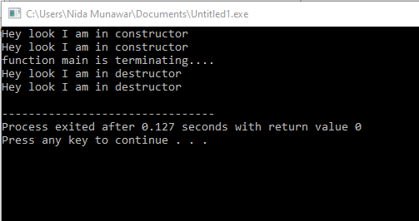

Slide 38
How destructors are different from a normal member function?
Destructors are functions with the same name as the class but preceded by a tilde (~)
Several rules govern the declaration of destructors. Destructors:
Do not accept arguments.
Do not return a value (or void).
Cannot be declared as const, volatile, or static. However, they can be invoked for the destruction of objects declared as const, volatile, or static

Slide 39
Can there be more than one destructor in a class? No, there can only one destructor in a class with classname preceded by ~, no parameters and no return type.
When do we need to write a user-defined destructor? If we do not write our own destructor in class, compiler creates a default destructor for us. The default destructor works fine unless we have dynamically allocated memory or pointer in class.

Slide 40
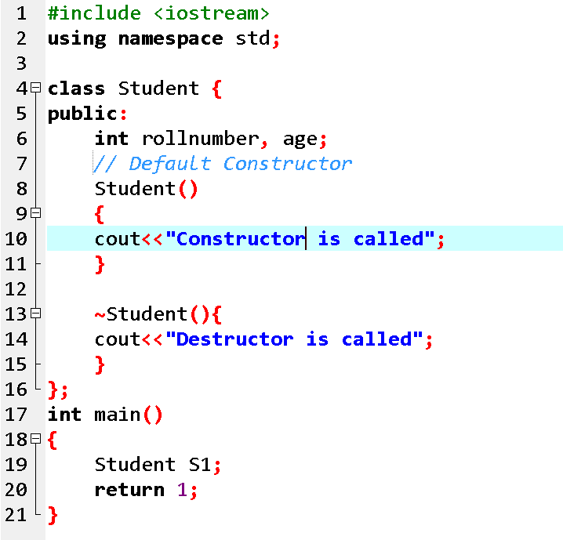

Slide 41
Exercise
Suppose you have a Piggie Bank with an initial amount of $50 and you have to add some more amount to it. Create a class 'AddAmount' with a data member named 'amount' with an initial value of $50. Now make two constructors of this class as follows: 1 - without any parameter - no amount will be added to the Piggie Bank 2 - having a parameter which is the amount that will be added to the Piggie Bank Create an object of the 'AddAmount' class and display the final amount in the Piggie Bank.

